Slide 1
Structural Smoothing Attribute
GPGN 458/558: Seismic Interpretation
Nadima Dwihusna
May 8th, 2019
Notes:
Filters are simple mathematical operators which, when convolved with seismic data, emphasize some aspect of the data, and de-emphasize others.
For example, a common step in seismic horizon interpretation is to apply a filter that reduces the high spatial frequencies in the data,
which are mostly attributable to noise, and emphasizes the lower frequencies.
This is a smoothing filter.
An 8 minute presentation covering:
- Mathematical description of the attribute. How it came about. Why is it important. References.
- Application of the attribute to one or several of your 3 group projects.
- What did you learn from the application. What does it tell you about the geology. How does it compare to other attributes. How would you use it down the road.

Slide 2
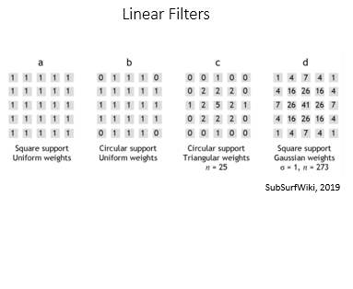
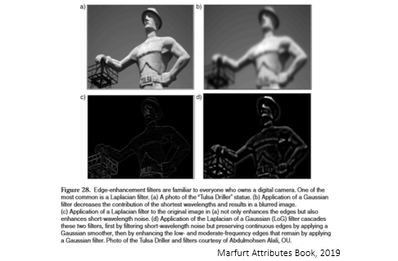
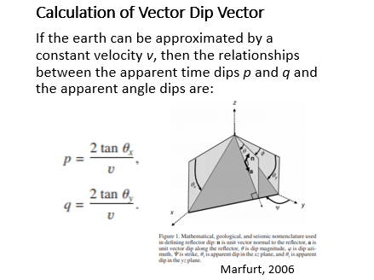
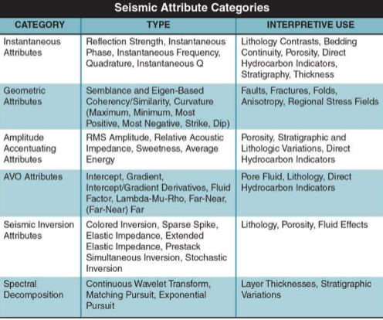

Structural Smoothing Attribute
Classical Seismic Attributes
1. Dip guiding (check box)
Option to determine if smoothing will be performed parallel to local structural orientation estimate.
Not selected: Performed traditional 3D Gaussian smoothing
Selected: Performed structurally guided Gaussian smoothing
2. Edge enhancement (check box)
Option to enhance the presence of edges detected with Dip guiding option.
Not selected: Do not enhance detected edges
Selected: Enhance detected edges
3. Filter size (Inline, Crossline, Vertical)
Filter size controls the number of traces horizontally and samples vertically to use for estimating smoothing.
The value represents the standard deviation for the Gaussian filter. The larger the value, the larger number of traces will be used.
Minimum: 0
Maximum: 10.0
Default: 1.5
Smoothing of input signal guided by the local structure to increase the continuity of the seismic reflectors (Randen, 2002)
Principal component dip and azimuth computation are used to determine the local structure
Gaussian smoothing is then applied parallel to the orientation of this structure
Roden, 2015
Notes:
On any digital image or seismic horizon, linear filters work by convolution with a moving window called a kernel. The input pixel is at the centre of the kernel. The non-zero part of the kernel is called the support of the filter. Most filters have a square support, though some are rectangular or circular. Some examples of kernels are shown here.
Linear filters operate in the same way on every input pixel, applying the same weights to the same pixels in the support. They are consequently very fast, but not sensitive to the character of the data, smoothing everything equally. This is their biggest weakness for geophysical applications, since faults and channel margins, say, are smoothed along with noise and picking artifacts.
Examples include the mean and Gaussian filters.

Slide 3
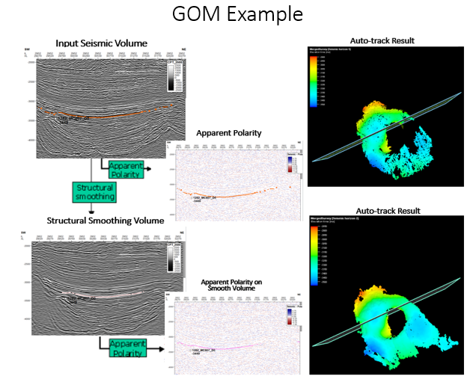
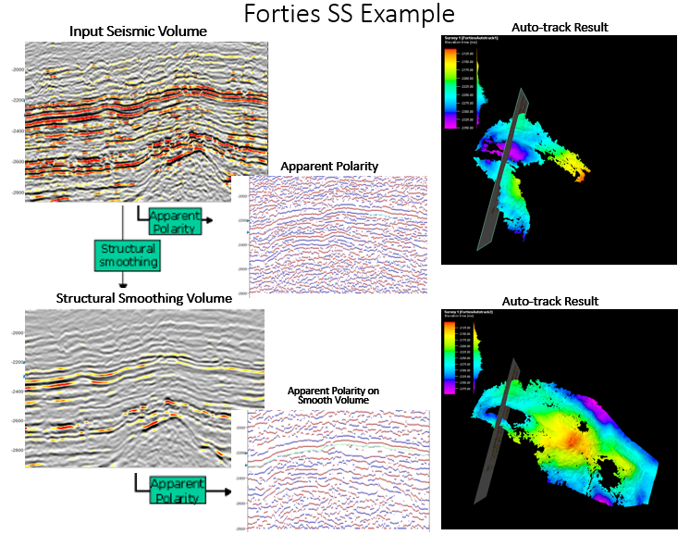
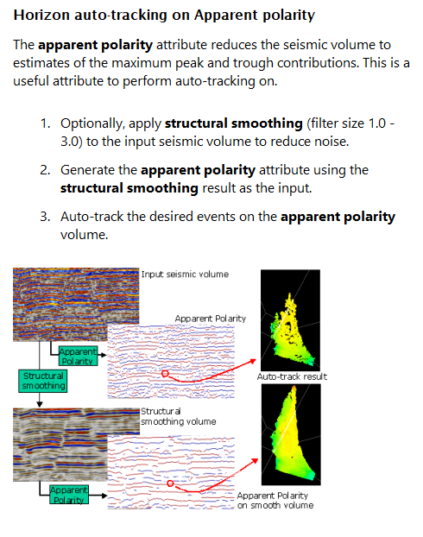
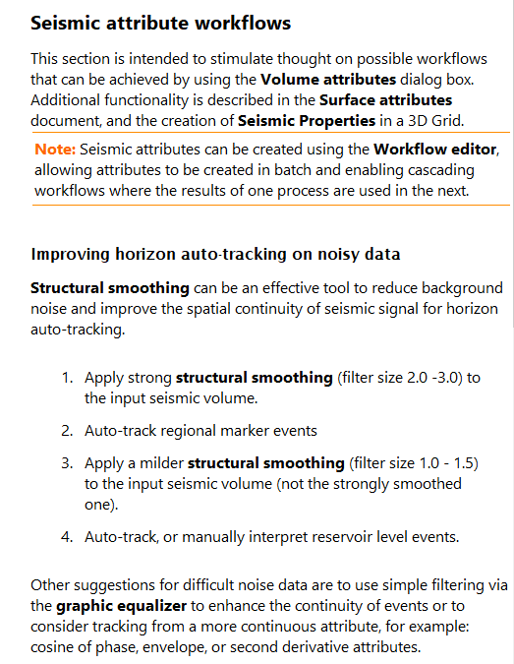
Application 1: Improving Horizon Auto-Tracking on Noisy Data
Notes:
This section is intended to simulate possible workflows that can be achieved using the volume attributes dialog box.
Additional functionality is described in the Surface attributes documents, and the creation of Seismic Properties in a 3D grid.
Used 1.5 filter

Slide 4
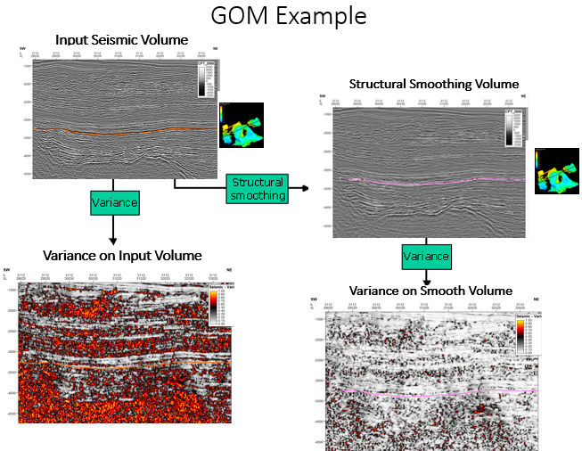
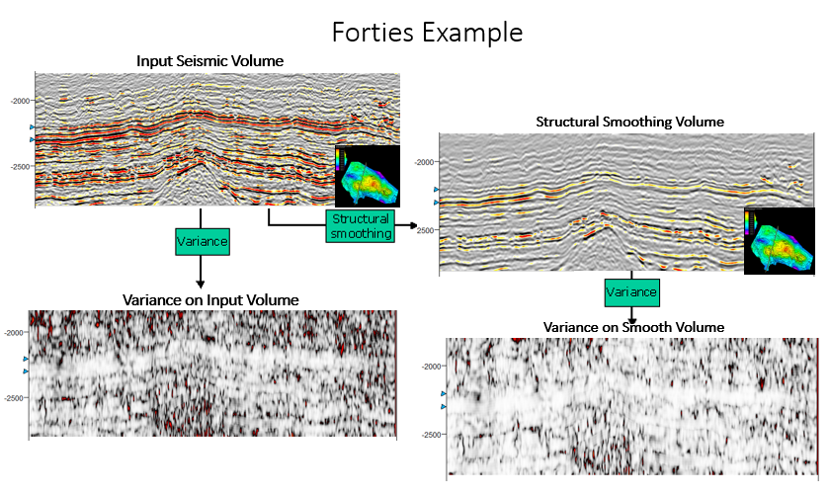
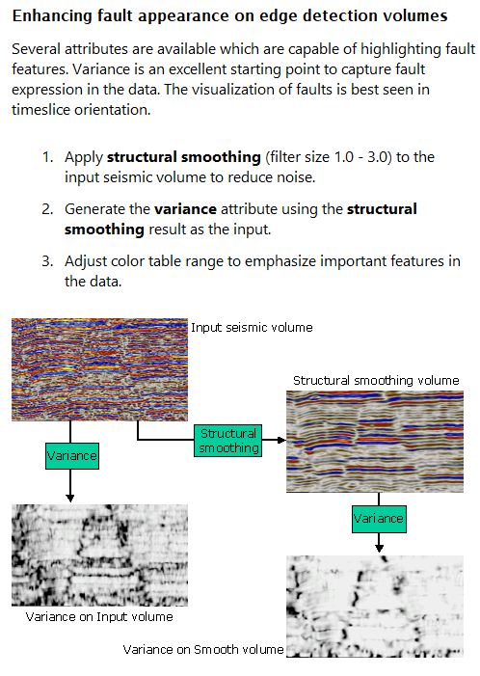
Application 2: Enhance Fault
Notes:
Delineation - the action of indicating the exact position of a border or boundary.
Forties:Inline range 3
Crossline range 3
Vertical smoothing 15
Dip correction off
GOM: Inline range 3, xline range 3, vertical smoothing 23

Slide 5
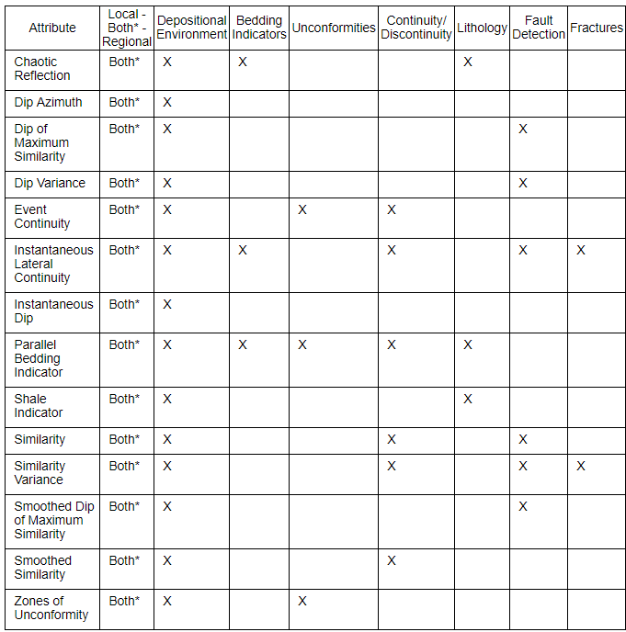
Summary
Several benefits of using Structural Smoothing Attribute:
Reduction of stratigraphic and structural risk
Improved delineation of potential reservoirs
Maximization of the value of older seismic data
Note: different geometric attributes shows different features
IHS Kingdom Tutorial, 2019
Notes:
- Mathematical description of the attribute. How it came about. Why is it important. References.
- Application of the attribute to one or several of your 3 group projects.
- What did you learn from the application. What does it tell you about the geology. How does it compare to other attributes. How would you use it down the road.

Slide 6
References
[1] Hall, M (2007). Smooth operator: smoothing seismic horizons and attributes. The Leading Edge 26 (1), January 2007, p16-20. doi:10.1190/1.2431821
[2] Marfurt, Kurt J. Seismic Attributes as the Framework for Data Integration Throughout the Oilfield Life Cycle. Society of Exploration Geophysics, Distinguished Instructor Series, No.21
[3] Petrel Guru Workflows and IHS Kingdom Tutorial

Slide 7
Appendix

Slide 8
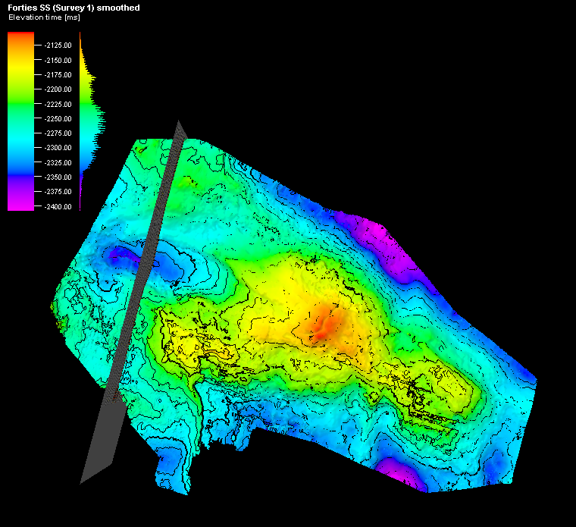
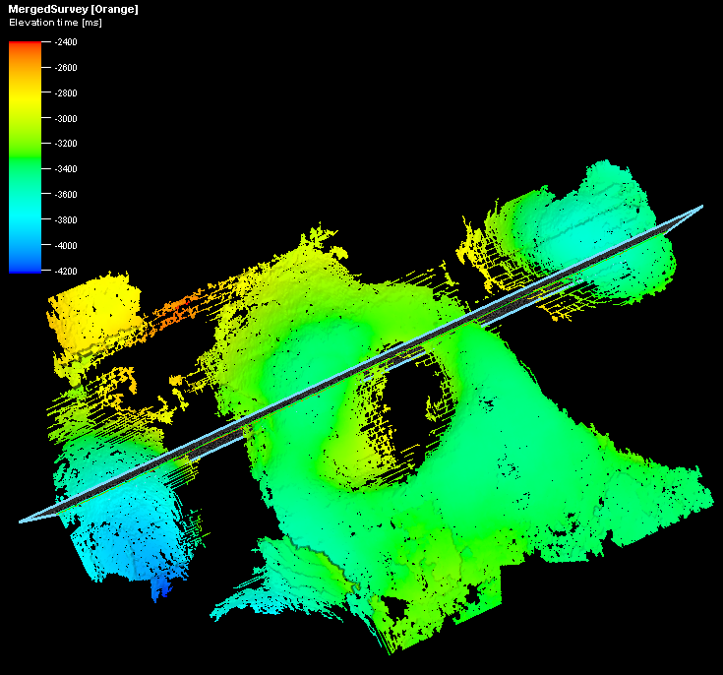
Original Time Structure Forties SS
Original Time Structure GOM
Notes:
Delineation - the action of indicating the exact position of a border or boundary.

Slide 9
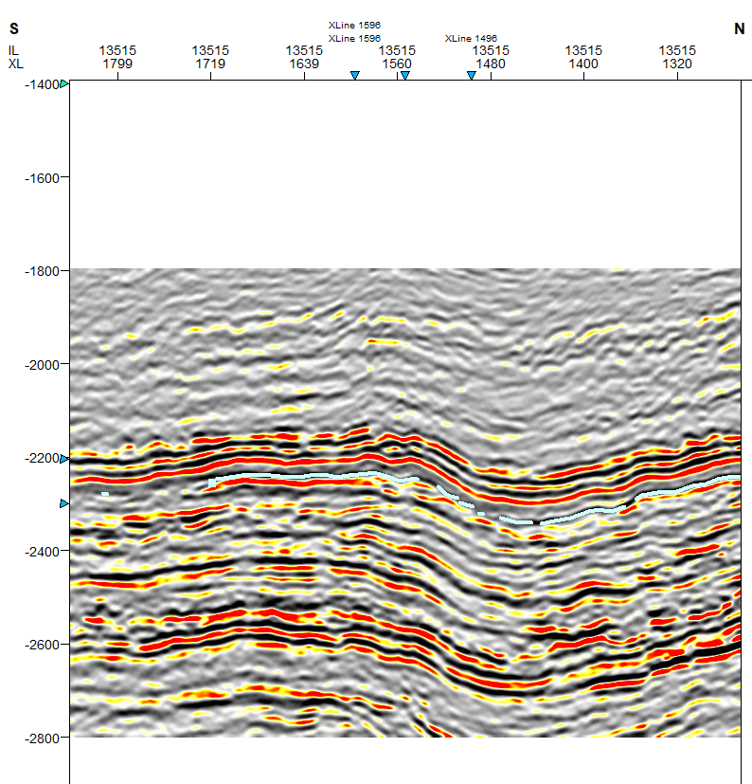
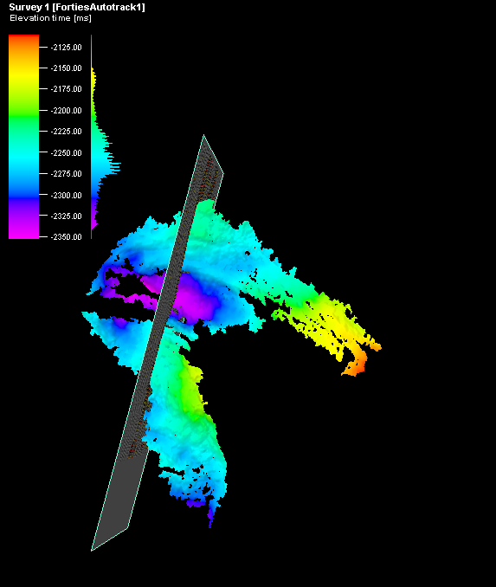
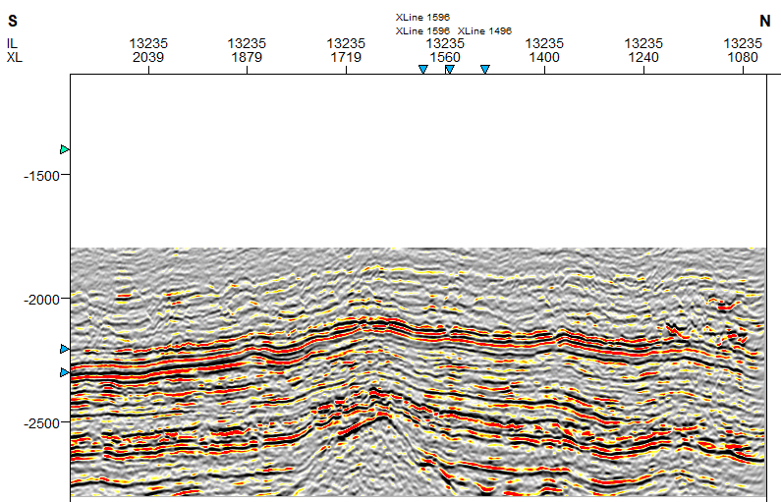
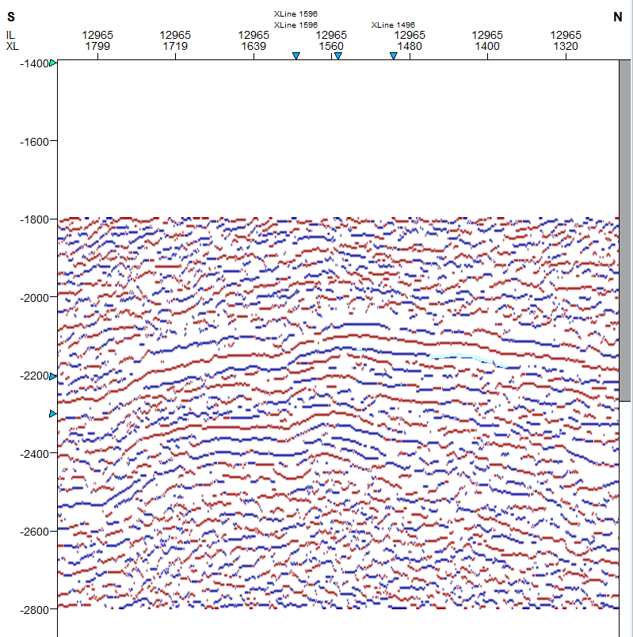
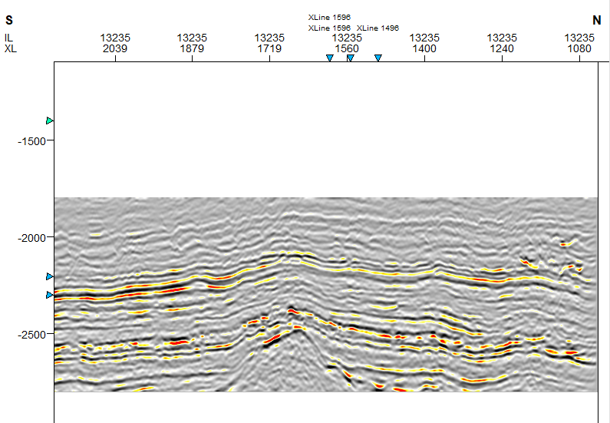
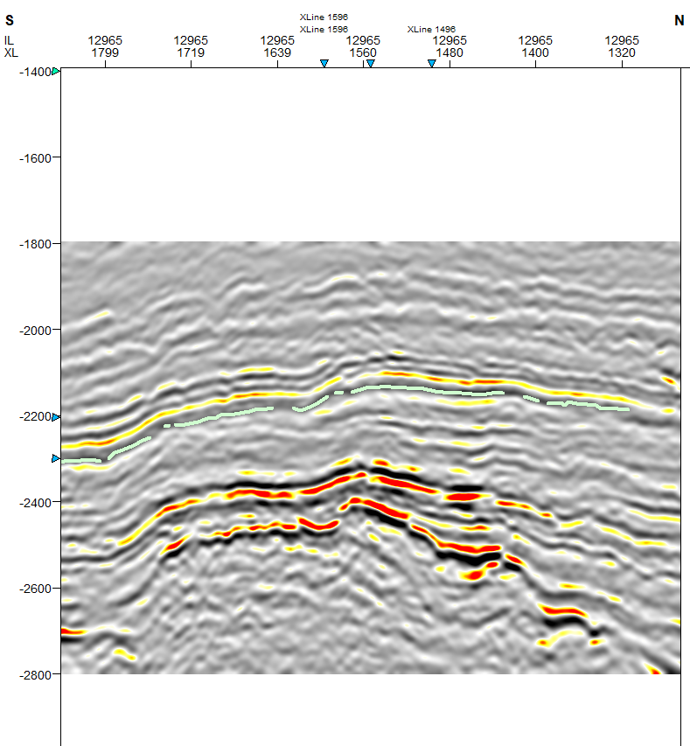
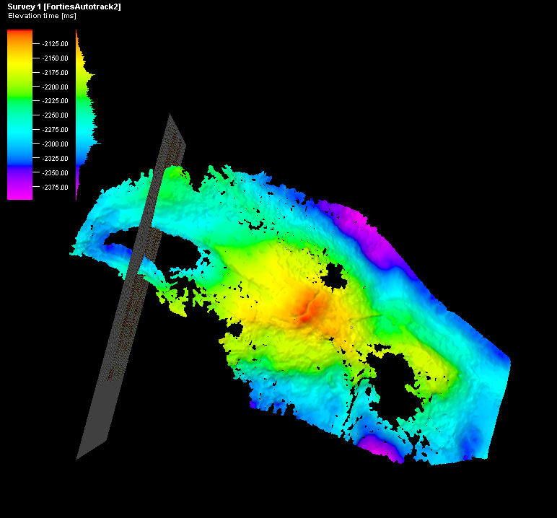
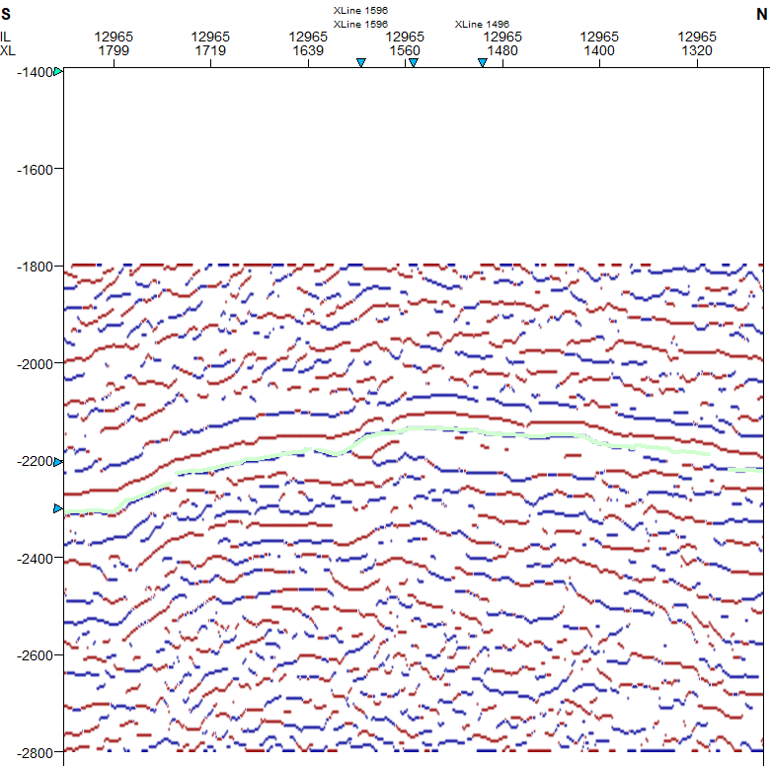
Input Seismic Volume
Forties SS Example
Auto-track Result
Apparent Polarity
Structural Smoothing Volume
Auto-track Result
Apparent Polarity on Smooth Volume
Notes:
Used 1.5

Slide 10
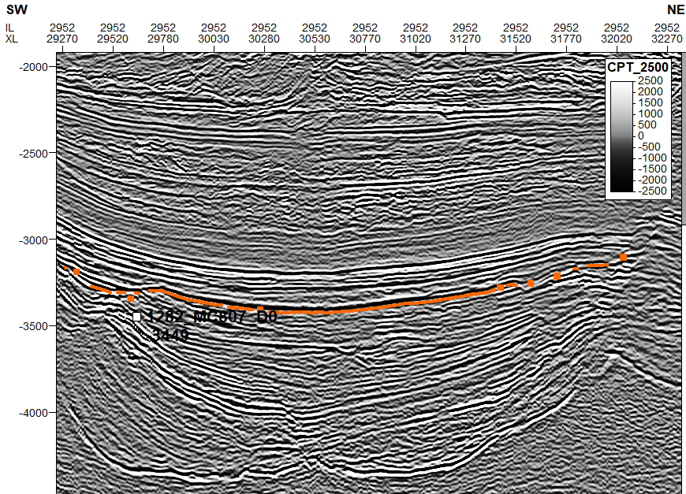
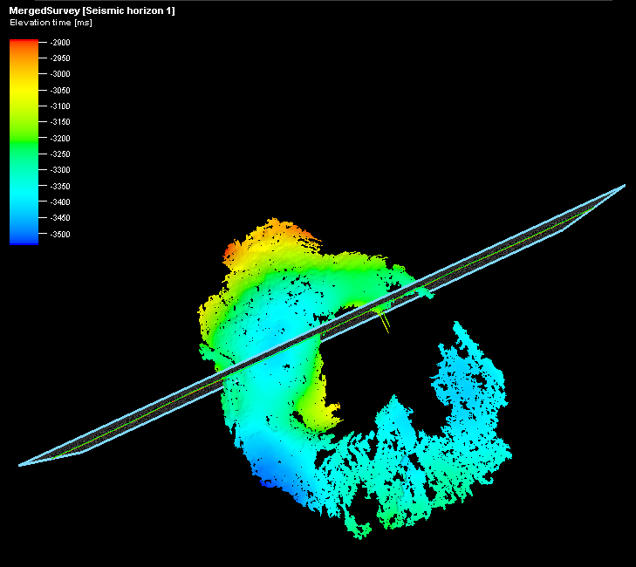
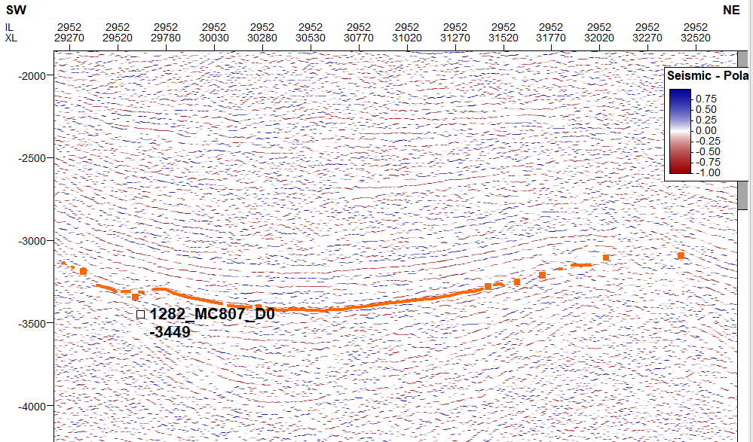
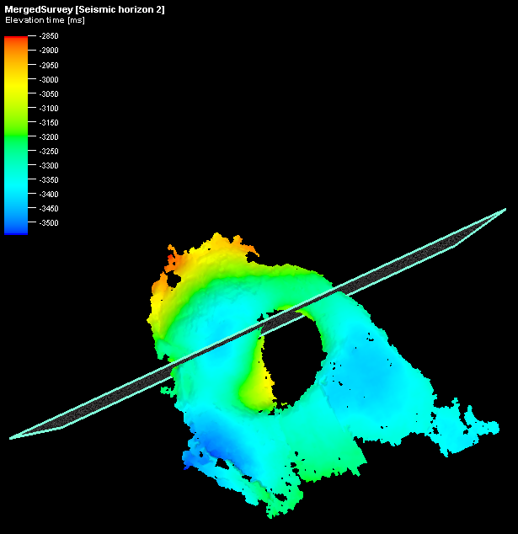
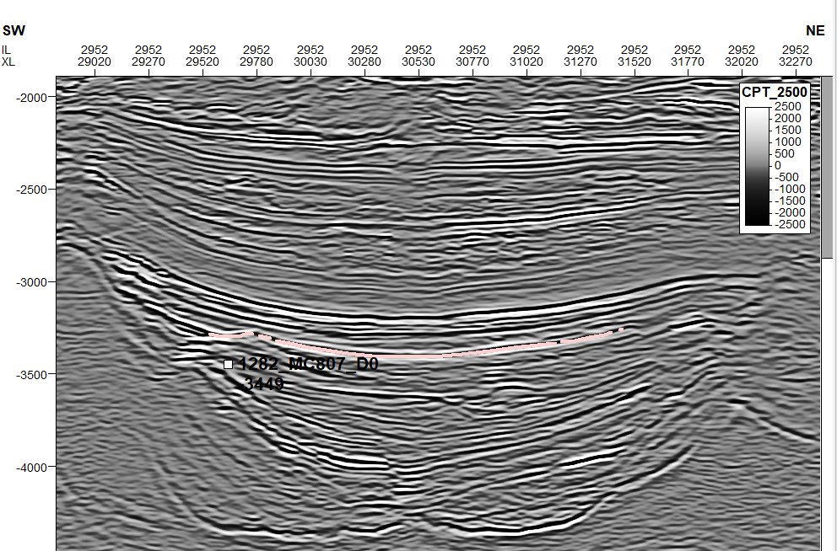
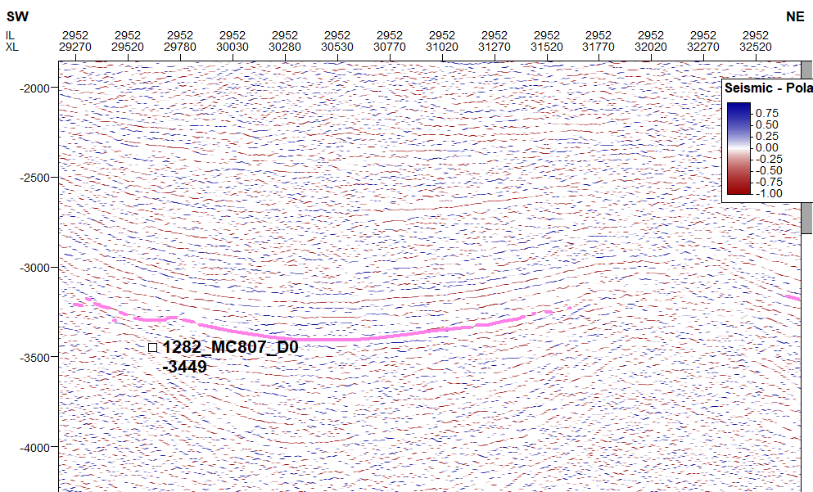
Input Seismic Volume
GOM Example
Auto-track Result
Apparent Polarity
Auto-track Result
Structural Smoothing Volume
Apparent Polarity on Smooth Volume
Notes:
Used 1.5

Slide 11
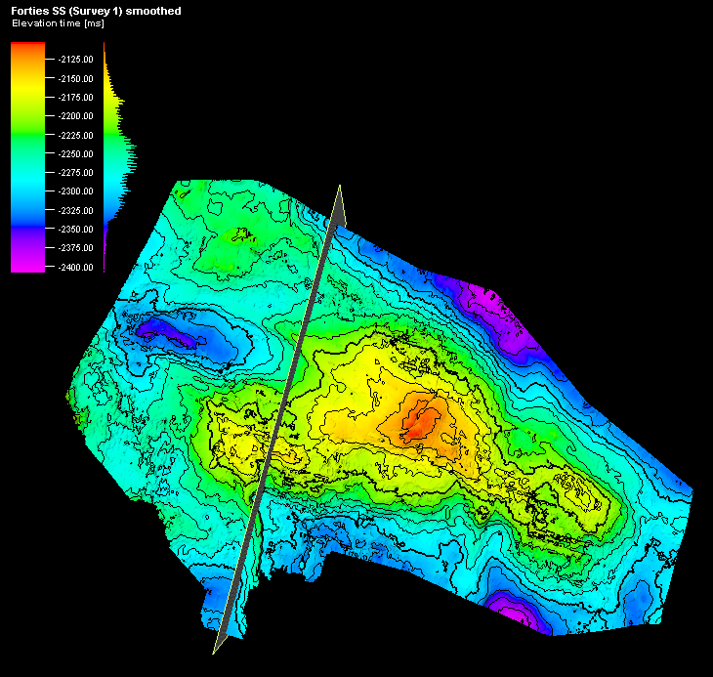
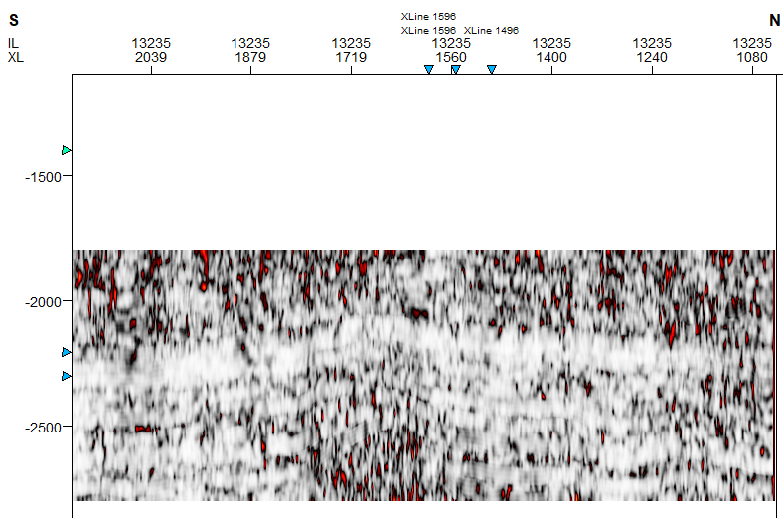
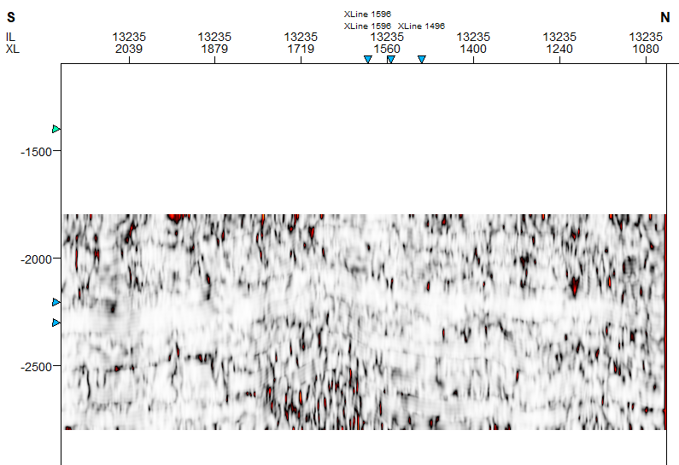
Forties Example
Input Seismic Volume
Structural Smoothing Volume
Variance on Input Volume
Variance on Smooth Volume
Notes:
Inline range 3
Crossline range 3
Vertical smoothing 15
Dip correction off

Slide 12
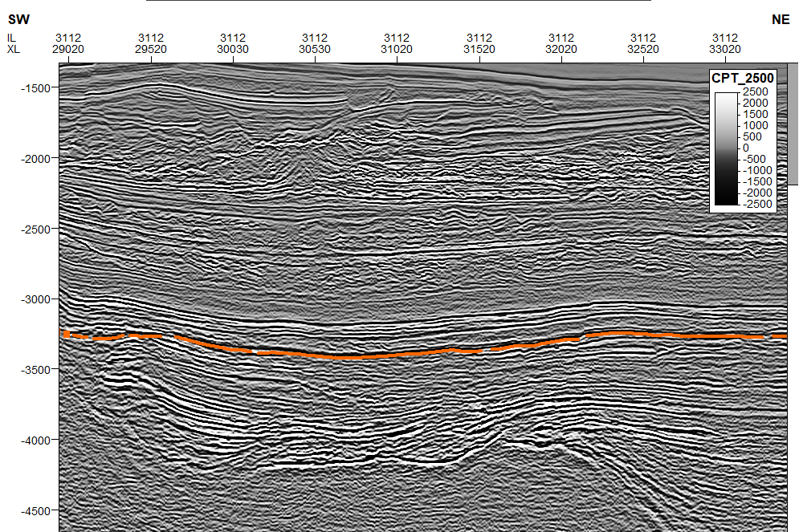
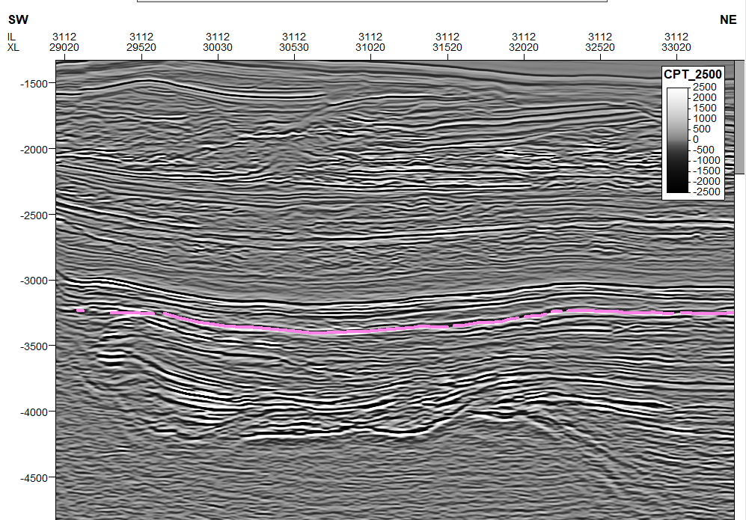
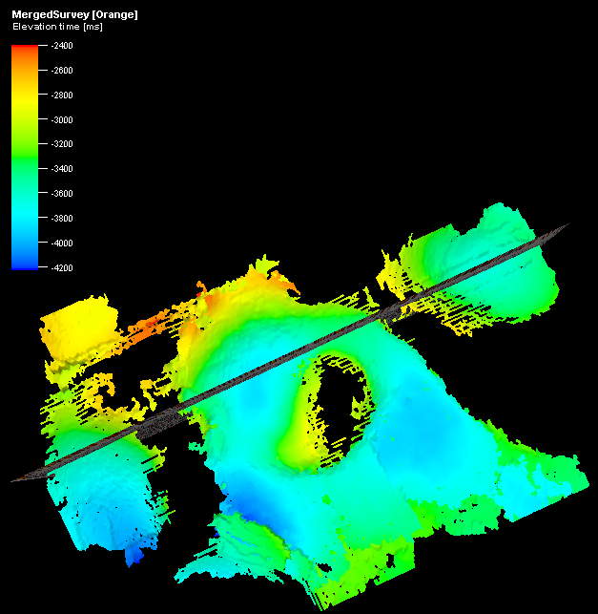
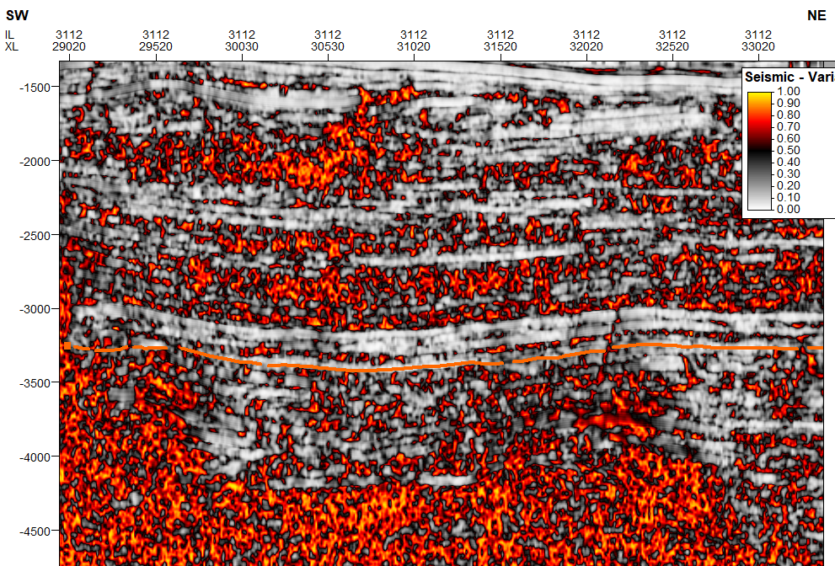
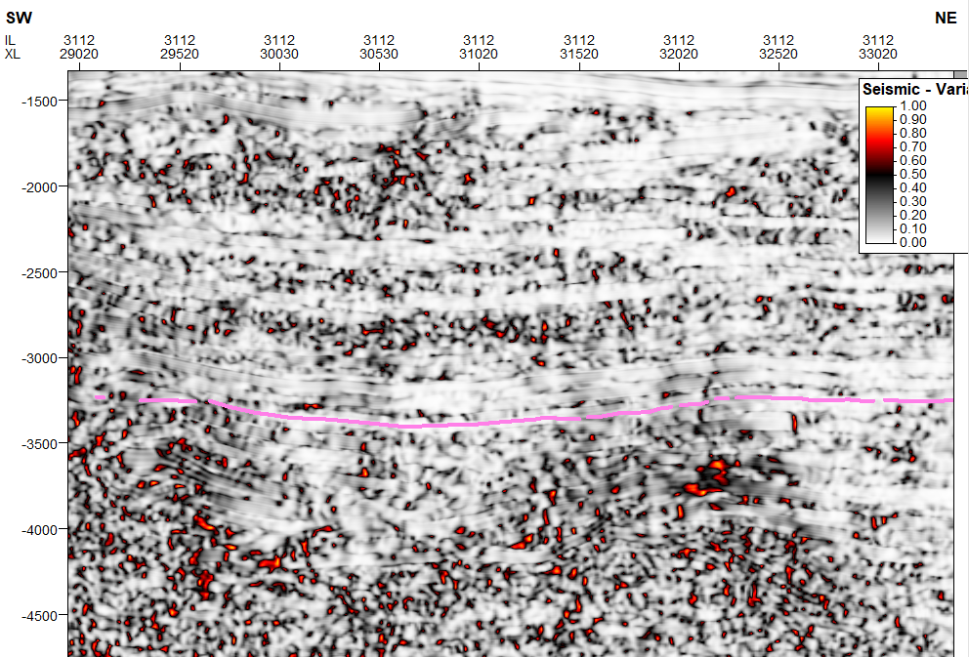
GOM Example
Input Seismic Volume
Structural Smoothing Volume
Variance on Input Volume
Variance on Smooth Volume
Notes:
Inline range 3
Crossline range 3
Vertical smoothing 15
Dip correction off

